Slide 1
Printmaking
ORANGE EASEL – March 2016

Slide 2
What is Printmaking?
Usually on paper
Most types of printmaking can produce multiples of the same piece, which is called a print.
Each print is considered an original
Choosen for it’s ability to produce multiples (yeah, commerce!) AND the unique qualities of the printmaking process.

Slide 3
Types of Printmaking
Monotyping/monoprinting
Block printing
Woodcuts
Lithography
Screenprinting
Gelatin printing (we’ll do this one at the end)

Slide 4
Practical applications
Can create multiple artworks for sale
Before computers and printers…books, newspapers, illustrations, wallpaper, and even fabrics were mass produced using PRINTING techniques.

Slide 5
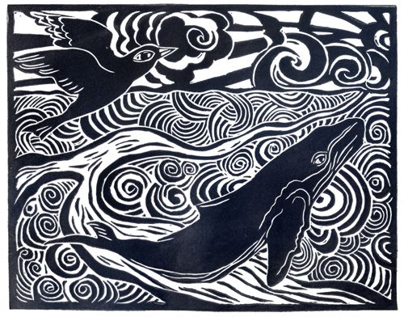

Slide 6
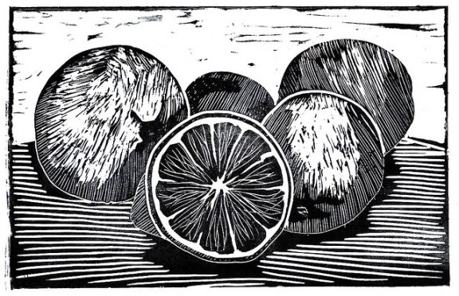

Slide 7
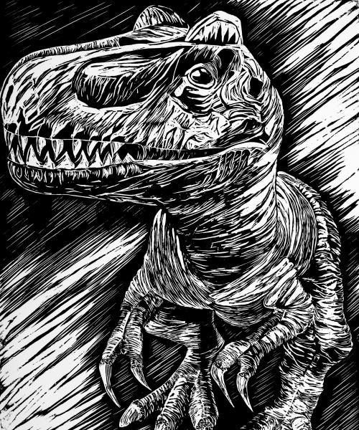

Slide 8
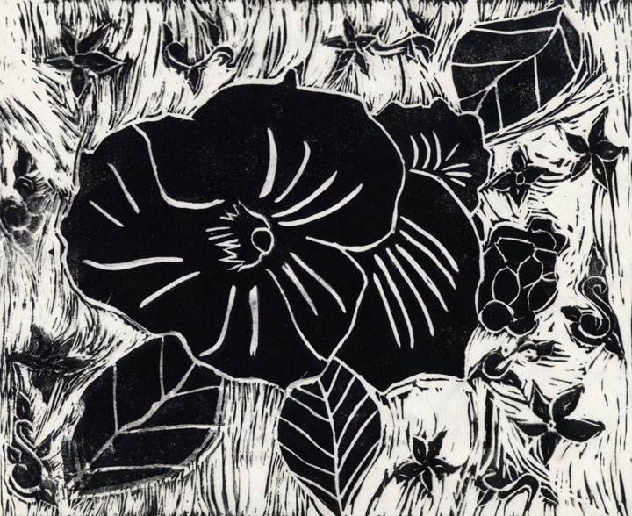

Slide 9
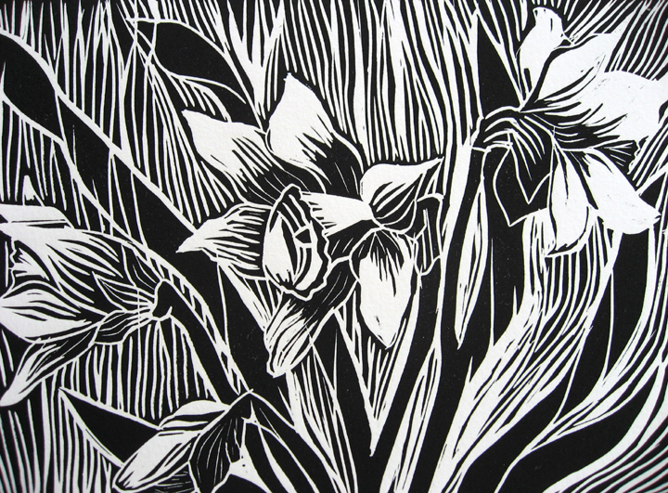

Slide 10
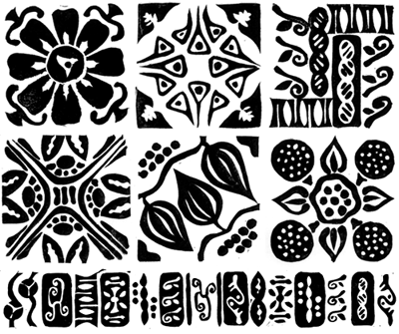

Slide 11
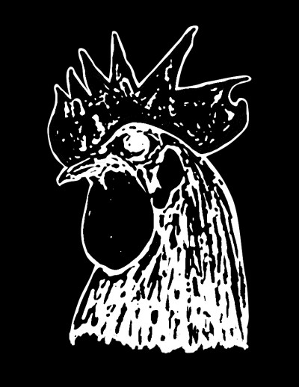

Slide 12
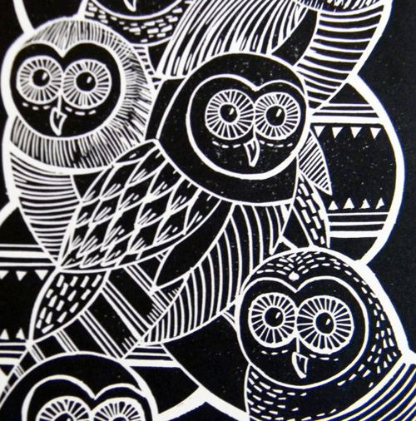

Slide 13
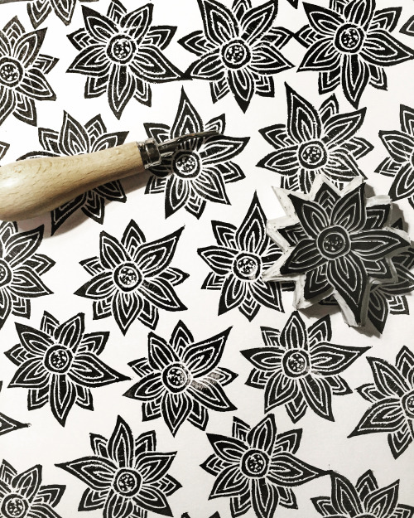

Slide 14
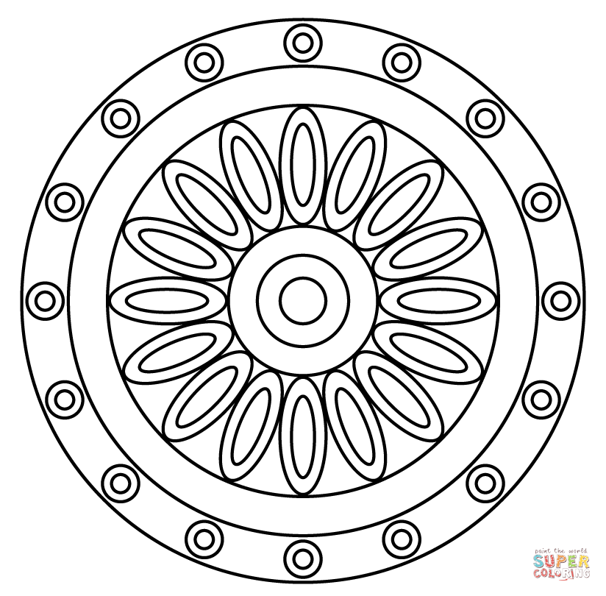
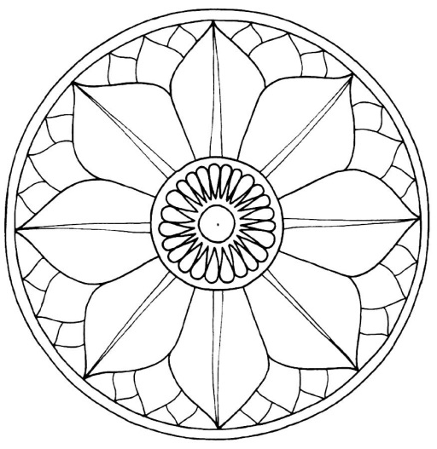
2nd/3rd Grade Mandala Examples

Slide 15
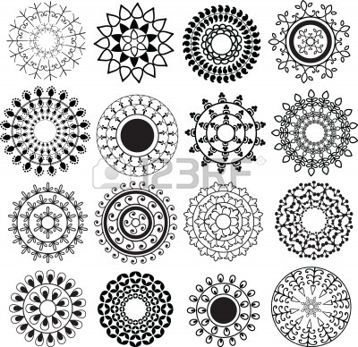
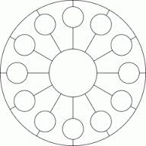

Slide 16
Printmaking examples for K/1st, 4th/5th and Middle School

