Slide 1
MIXED MEDIA
ORANGE EASEL
School of Art

Slide 2
What is Mixed Media
Type of artwork employing more than one media
Lots of layering
Simple subject matter
Incorporation of words

Slide 3
Examples of Mixed Media
Background
Subject
Composition
Focal point
Embellishments
Texture

Slide 4
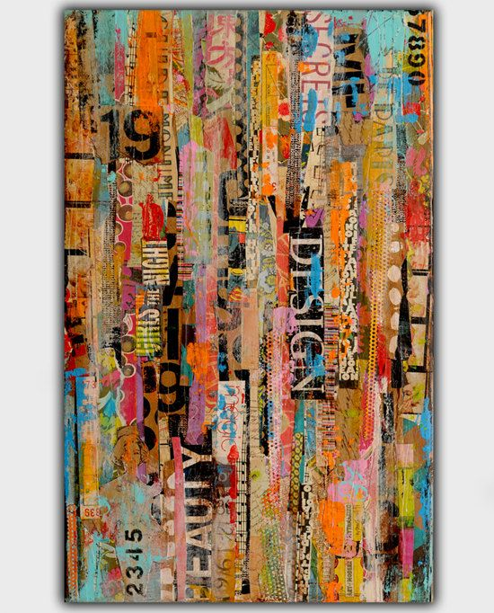

Slide 5
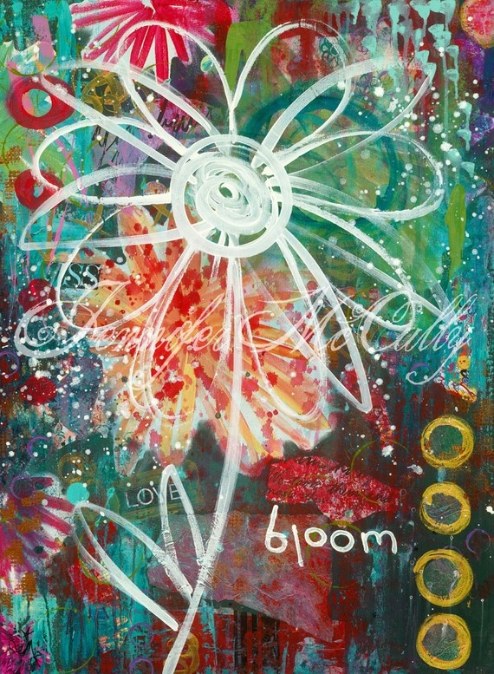

Slide 6
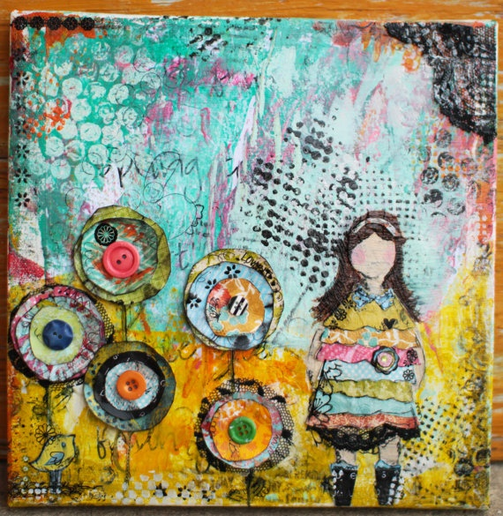

Slide 8
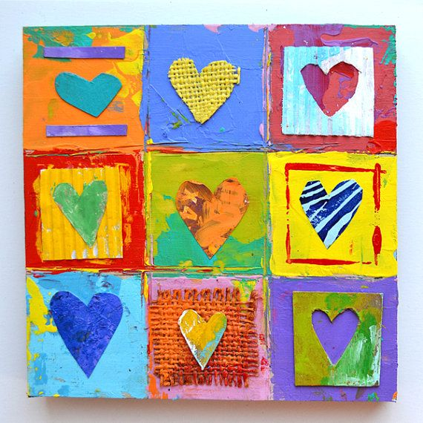

Slide 9
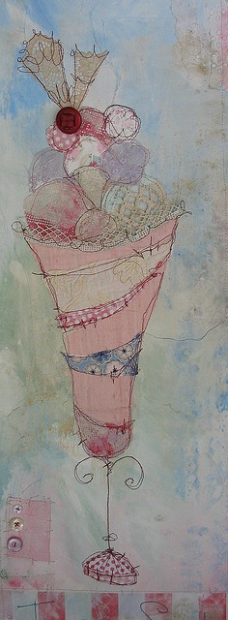

Slide 10
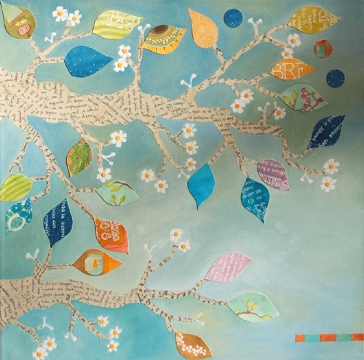

Slide 11
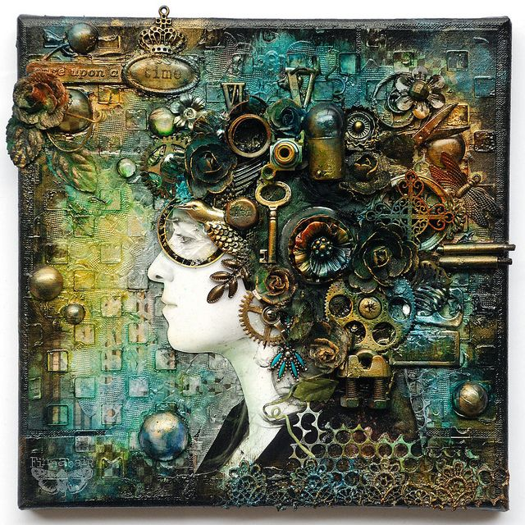

Slide 13
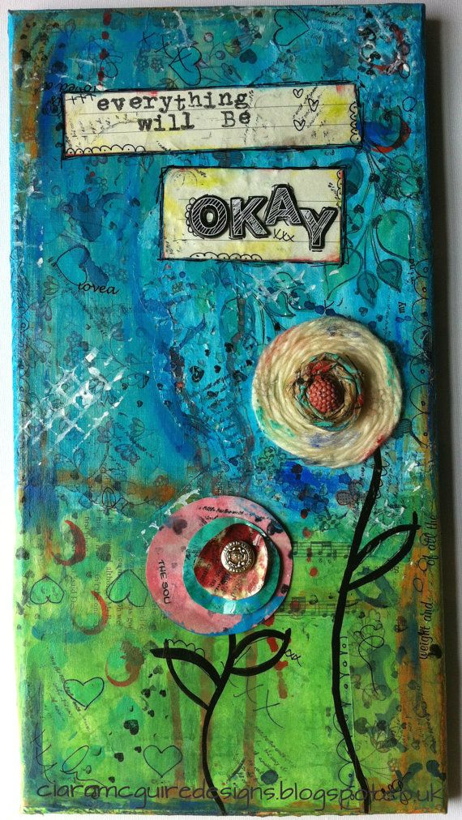

Slide 14
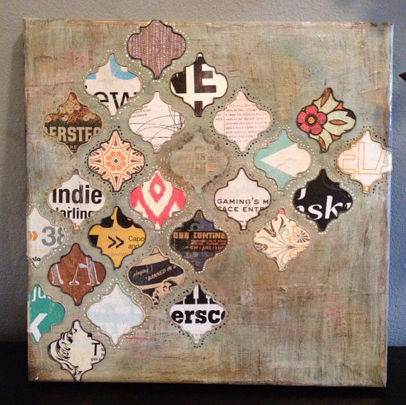

Slide 16
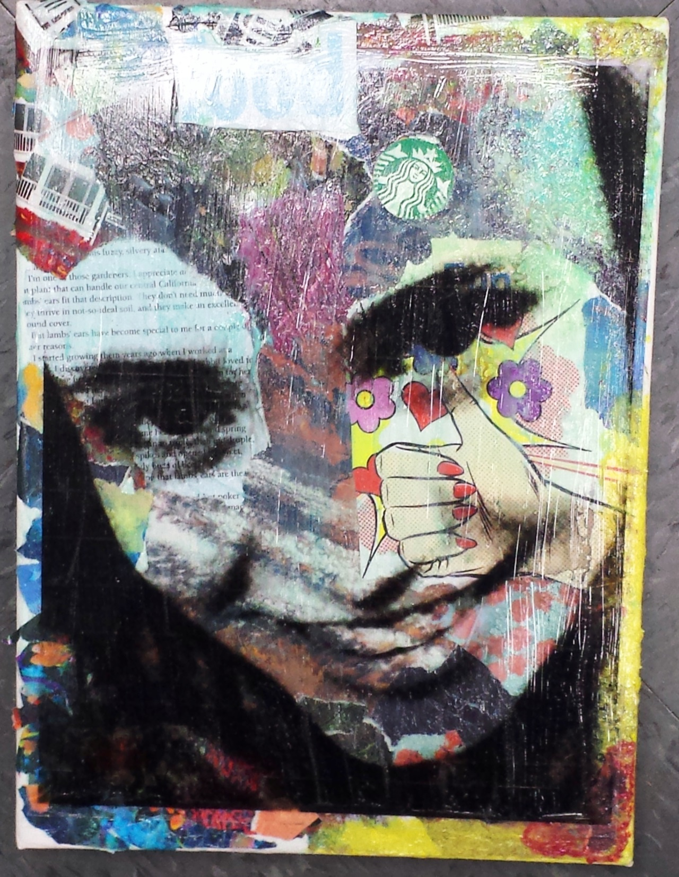

Slide 17
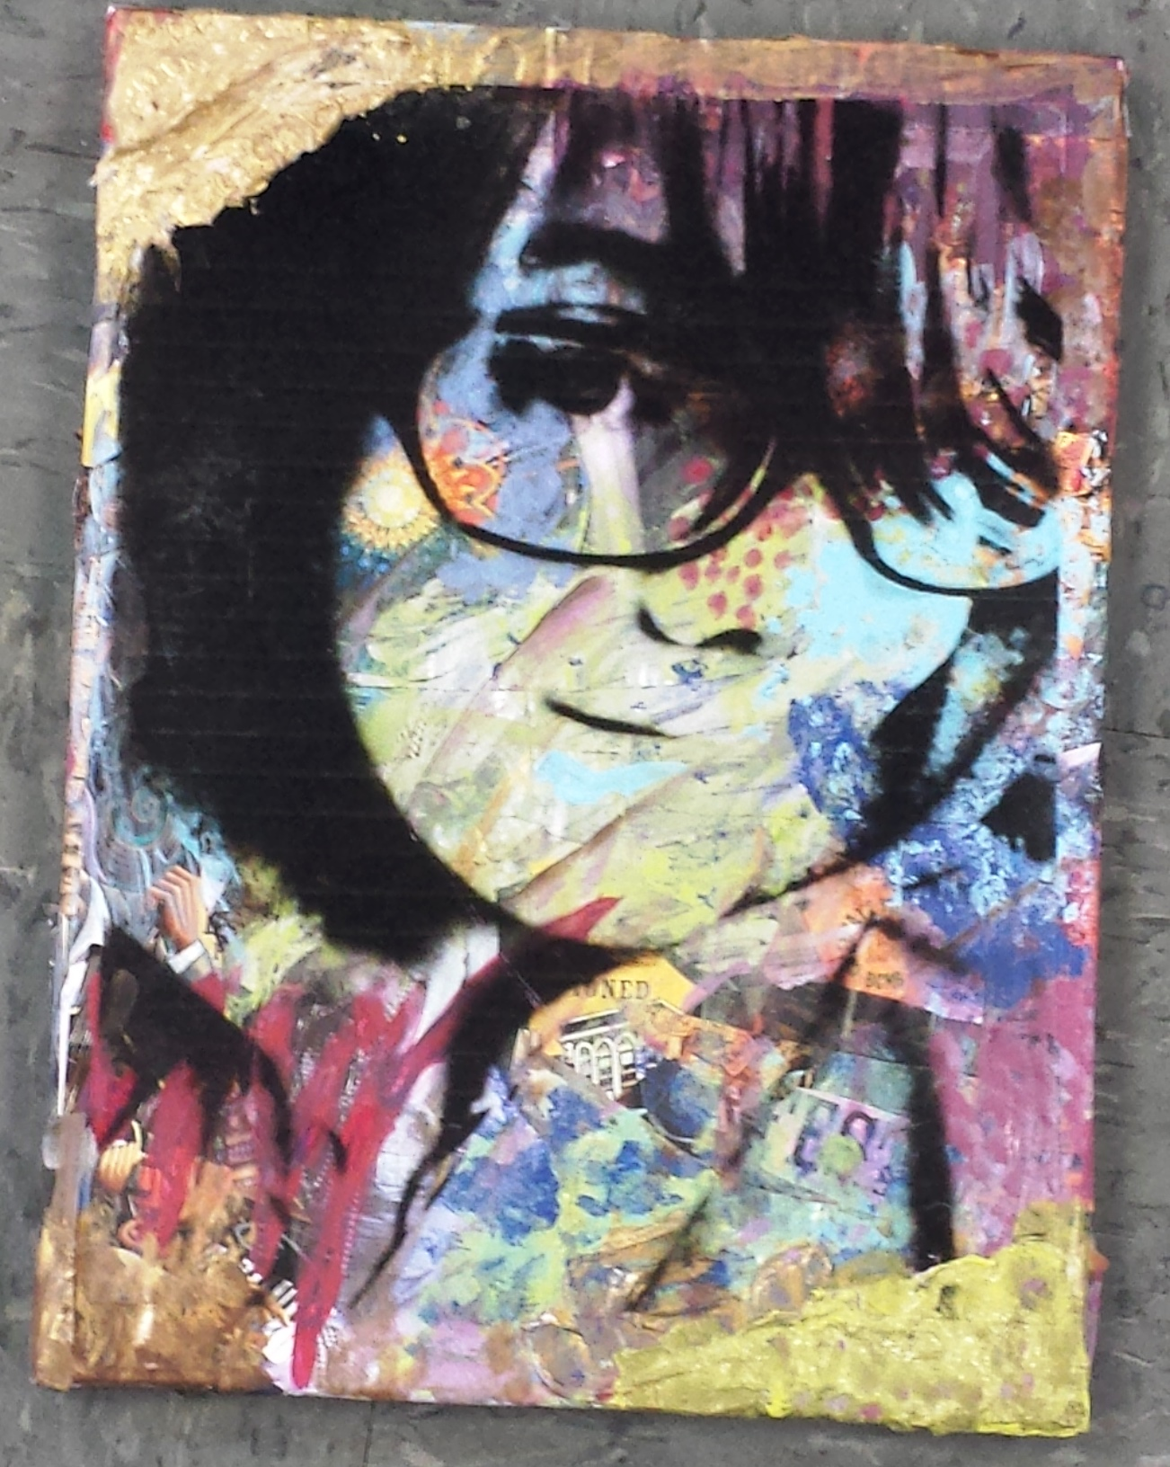

Slide 18
